Slide 1
Understanding the analysis of medical
data in the field of healthcare
Notes:
CLICE 1<In this video, we'll examine the Heart Failure Dataset.
The dataset used in this course is an open dataset. The Heart Failure Dataset is an online source, and it is in a CSV (comma separated value) format. Let's use this dataset as an example to practice data reading.
The data contains the complete history of heart patients (so data scientists from different parts of the world can work with it). The dataset is collected from Pakistan, Faisalabad hospital named institute of cardiology.>

Slide 2
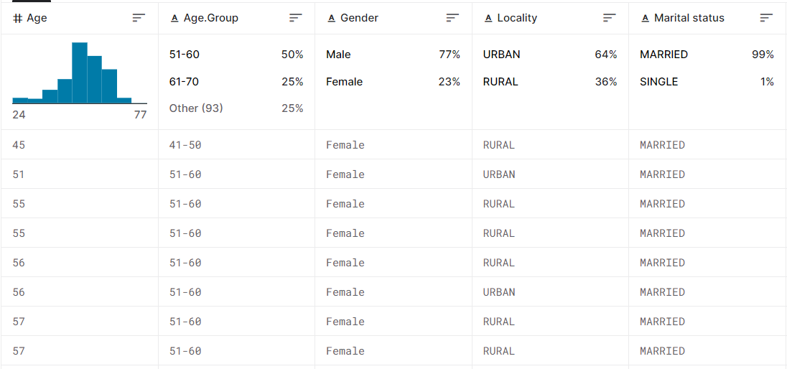
The Heart Failure Prediction Dataset (CSV)
About this dataset
Age : Age of the patient
Age Group: Such as 21-30 and 31-40 are grouped
Gender : Sex of the patient
Locality: Rural or Urban
Marital status: Married or unmarried
Smoking: yes/no
Depression: yes/no
Mortality: Died= 0 and Alive= 1
Follow.Up: Number of visiting time
cp : Chest Pain type chest pain type
Diabetes: 0 means yes and 1 means no
chol : cholestoral in mg/dl fetched via BMI sensor
fbs : (fasting blood sugar > 120 mg/dl) (1 = true; 0 = false)
trestbps : resting blood pressure (in mm Hg)
rest_ecg : resting electrocardiographic results Value 0: normal Value 1: having ST-T wave abnormality (T wave inversions and/or ST elevation or depression of > 0.05 mV) Value 2: showing probable or definite left ventricular hypertrophy by Estes' criteria
thalach : maximum heart rate achieved
PLATELET_COUNT
Hemoglobin and much more, see dataset
Data source: https://www.kaggle.com/datasets/asgharalikhan/mortality-rate-heart-patient-pakistan-hospital
Notes:
CLICE 1 <The Pandas Library is a helpful tool that enables us to read various datasets into a data frame; our Jupyter notebook platforms have a built-in Pandas Library, so we only need to import Pandas without installing them.
You are running the lab in your browser, so we will install the libraries using piplite>

Slide 3
Question
What does each line in the csv file represent?
row
column
Header
Notes:
CLICE 1 <Question
What does each line in the csv file represent?>

Slide 4
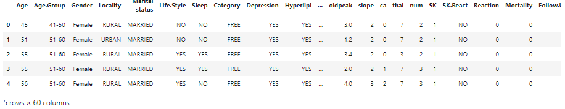
Each of the attributes in the dataset
Target (Label)
Attributes description: https://www.kaggle.com/datasets/asgharalikhan/mortality-rate-heart-patient-pakistan-hospital
Notes:
CLICE 1 <This Heart Failure Datasetdataset is in CSV format, which separates each of the values with commas, making it very easy to import into most tools or applications.
Each line represents a row in the dataset.
The ability to read, manipulate, and write data to and from CSV files using Python is a crucial skill to master for any data scientist or business analyst.>
CLICE 2 <A “CSV” file, that is, a file with a “CSV” file type, is an important text file. A text editor like NotePad on Windows or TextEdit on Mac can open a CSV file and show the contents. Sublime Text is an attractive and multi-functional text editor option for any platform.
CSV is a standard for storing tabular data in text format, where commas are used to separate the different columns, and newlines (carriage return/press enter) are used to separate rows. Typically, the first row in a CSV file contains the names of the columns for the data.
An example table data set and the corresponding CSV-format data are shown in the Table below.
Note that almost any tabular data can be stored in CSV format – the format is popular because of its simplicity and flexibility. You can create a text file in a text editor, save it with a .csv extension, and open it in Excel or Google Sheets to see the table form.>
CLICE 3 <The first row of our dataset is the header, which contains the column name for each of the 60 columns.
There are many columns, and I will only cover a few column names, but you can also check the link at the bottom of the slide to see the descriptions yourself.
The first attribute, Age - Age of the patient. Second - Age group: such as 21-30 and 31-40 are grouped. This is Target (Label).
Attributes description: Third - Gender: Target (Label) - the gender of the patient. Fourth - Locality: Target (Label) - rural or urban. Fifth - Marital status: Target (Label) - married or single.
Other attributes are easy to understand.
If you want more details, follow the link at the bottom of the slide.>

Slide 5
Question
What is the name of the attribute that we want to predict
data frame
feature
target (label)
Notes:
CLICE 1 <Question
What is the name of the attribute that we want to predict>
data frame
feature
target (label)

Slide 6

IBM Developer
Notes:
CLICE 1 <Thus, this project aims to predict heart diseases in patients. Applying machine learning methods, it is possible to perform qualitative data analysis, the results of which can significantly reduce the risk of heart disease by changing the patient's lifestyle.
But remember that this exercise aims to learn how to analyse the data.>

